Slide 1
StreamFlix Global Viewer Insights
Alexander Brown Anisha Issac Laura Vuong Sreelakshmi Sudey

Slide 2
Top 10 Movies

Slide 3
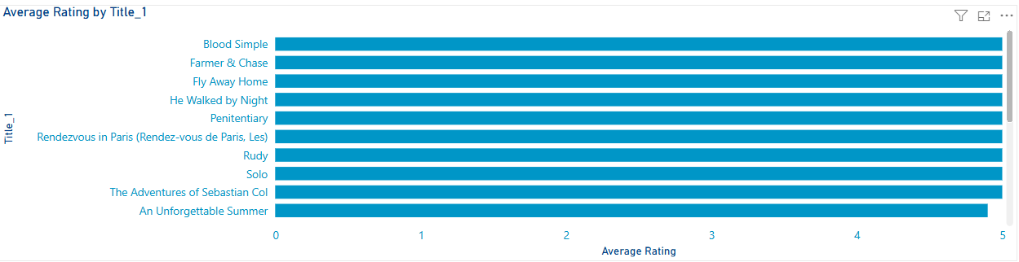

Slide 4
Most Popular Genres

Slide 5
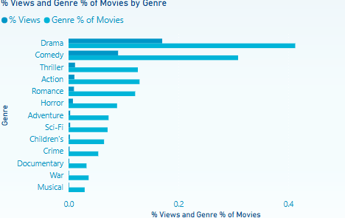
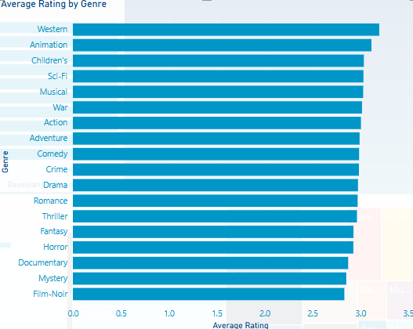

Slide 6
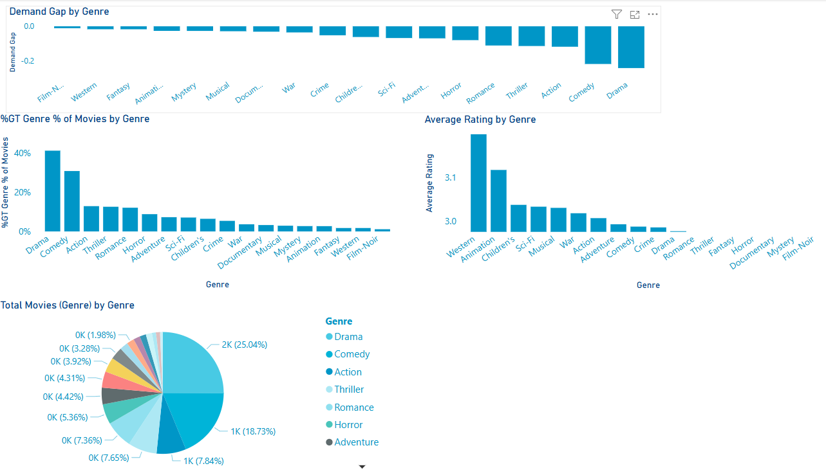

Slide 7
Age Group & Device

Slide 8
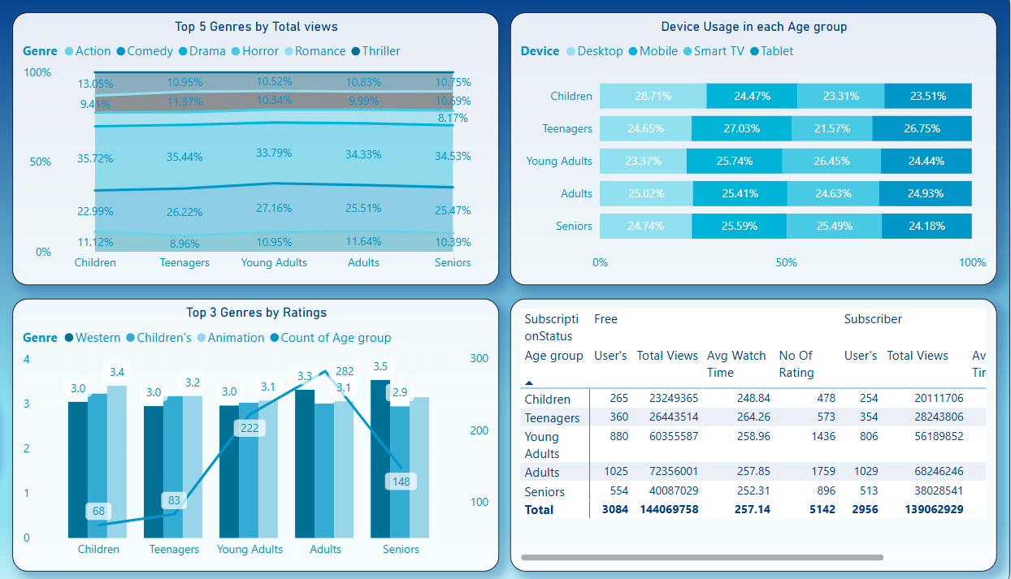
Age Group
Children (<12)

Slide 9
Age Group
Teenagers (13 - 19)

Slide 10
Age Group
Young Adult (20 - 35)

Slide 11
Age Group
Adult (36 - 55)

Slide 12
Age Group
Senior (>55)

Slide 13
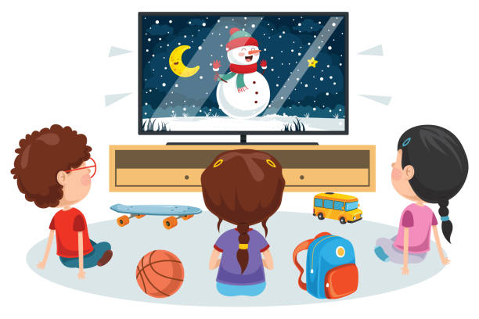




Children
Promote animation content more in the home page and recommendations.
Even though thriller is watched more, animation emotionally resonates better.
Develop a child-friendly desktop interface with parental controls.
Teenagers
Deprioritize action content in their recommendations; focus more on romance and drama.
Optimize mobile/tablet streaming experience (e.g., UI design, quick access).
Recommend binge-worthy series or short-form content formats.
Age Group
Recommendation
Young Adult
Strengthen the library of comedy and drama content.
Consider features that enhance Smart TV user experience like personalized watchlists, shared viewing features, or watch parties.
Highlight trending comedies for this segment.
Adults
They are heavy viewers compared to other age group, so target them by continue investing in drama and action genres.
Target this group with mobile-friendly content and offline viewing options.
Use in-app notifications or personalized suggestions to retain high engagement.
Seniors
Reinforce drama and western genres.
Simplify navigation for mobile and TV users; ensure accessibility (e.g., subtitles, large fonts).
Recommend nostalgic or classic content for emotional engagement.

Slide 14
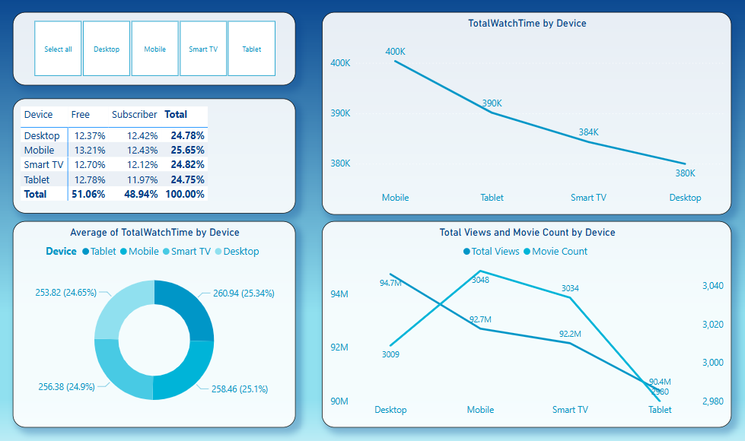
Device - Mobile

Slide 15
Device - Desktop

Slide 16
Device – Smart TV

Slide 17
Device - Tablet

Slide 18


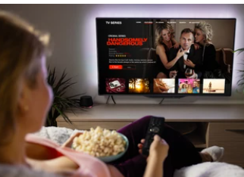
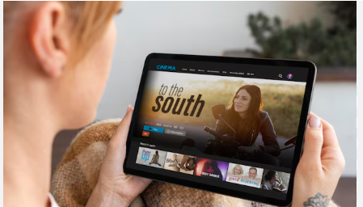

Convert Mobile Viewers with Targeted Offers
Launch mobile-first upgrade campaigns for free users.
Use in-app prompts after binge sessions to suggest Premium.
Highlight mobile perks like offline downloads, ad-free streaming, and early access.
Leverage Desktop Usage for Premium Features
Promote multi-device streaming and premium video quality.
Offer feature comparisons between free vs. paid plans during desktop sessions.
Trigger upgrade prompts after users hit high view thresholds.
Device
Recommendation
Enhance Smart TV Experience for Family Plans
Encourage paid plans with multi-profile access, parental controls, and exclusive content.
Highlight Smart TV benefits during evening/weekend viewing hours.
Boost Tablet Engagement Among Subscribers
Promote long-form or immersive content on tablets (e.g., series, documentaries).
Offer tablet-specific trials o rewards for consistent tablet viewers.
Improve UX and app performance if needed.
Use Personalized Messaging Across Devices
Show upgrade prompts like: “You’ve watched 5+ movies this week – unlock unlimited access!” “Your screen is perfect for Premium HD – Try it now.”

Slide 19
Subscription Status Analysis
Free vs. Subscribed Users

Slide 20
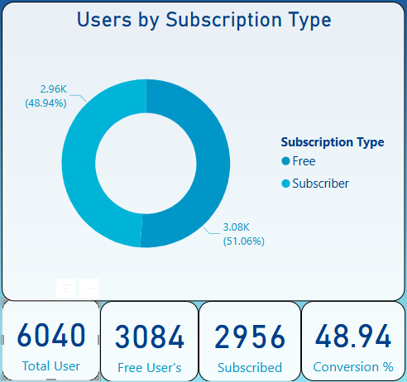
A nearly even split:- opportunity to convert Free users with targeted upsell campaigns.

Slide 21
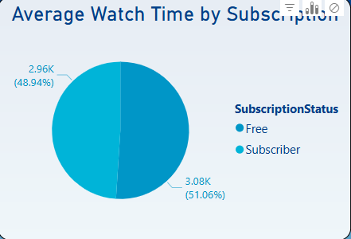
Watch time is almost identical across both groups. Content is engaging even in the free tier.

Slide 22
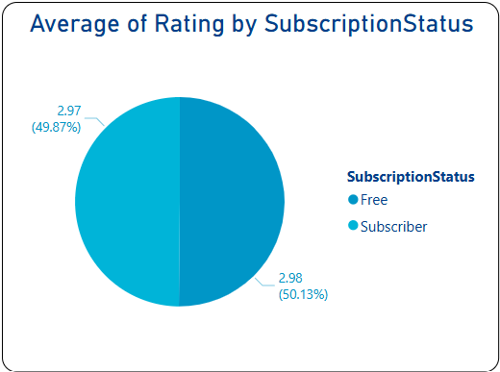
Users rate similarly regardless of subscription. Focus on maintaining quality over pricing.

Slide 23
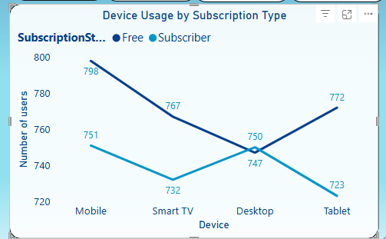
Mobile is the top device among Free users, a smart place to prompt subscription upgrades.

Slide 24
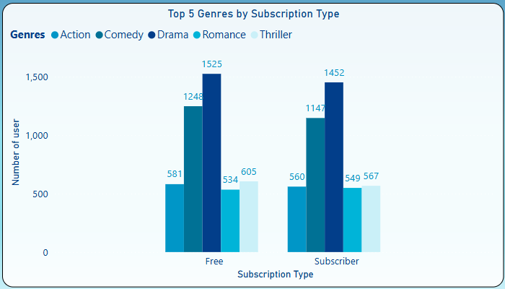
Drama and Comedy lead across both groups. Prioritise these in content and marketing placement.

Slide 25
Recommendations
Focus push notifications on mobile free users with premium previews.
Use Drama & Comedy content to promote subscriptions.
Since watch time and ratings are nearly equal, pricing nudges and exclusive features might convert better than content gating.

Slide 26
Subscription Analysis by Country
Comparing user behaviour and engagement across countries, by Subscription Status.

Slide 27
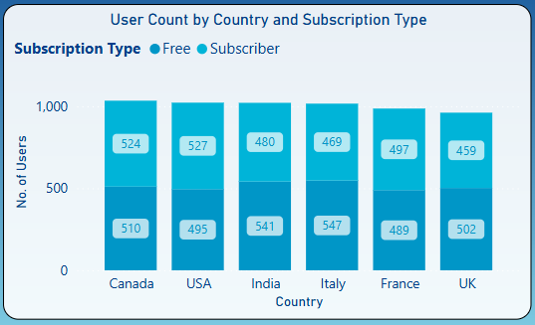
Canada, USA, and India lead in user count. High Free user base in India and Italy signals opportunity for growth.

Slide 28
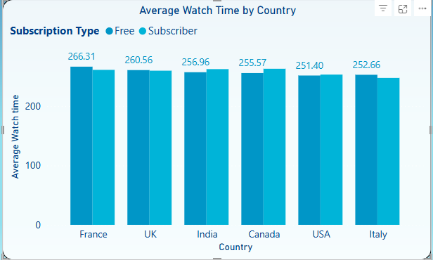
Free users in France show highest watch time. Watch time is fairly consistent across subscription tiers.

Slide 29
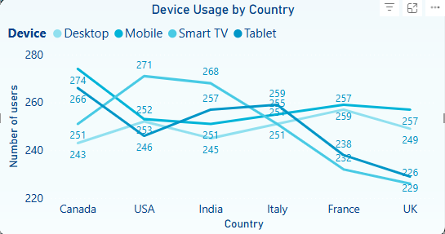
Mobile and tablet dominate across all countries. Tailor subscription prompts to device usage patterns.

Slide 30
Key Insights & Recommendations
Target France for Free-to-Subscriber conversion
Optimise UI for mobile-first countries subscriptions.
Reinforce value in high-subscription regions
Geo-personalised engagement

Slide 31
Thankyou !!!

